Slide 1
Module-3
3.1.

Slide 2
Decision Tree Learning
Part -1
Concept of Decision tree and Divide & Conquer Approach

Slide 3
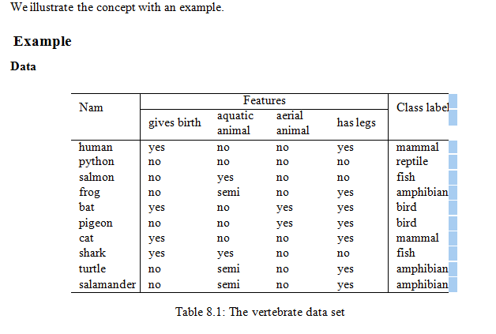
  Classification trees -Concept of Decision Tree
Consider the data given in Table 8.1 which specify the features of certain vertebrates and the class to which they belong. For each species, four features have been identified: “gives birth”, ”aquatic animal”, “aerial animal” and “has legs”. There are five class labels, namely, “amphibian”, “bird”, “fish”, “mammal” and “reptile”. The problem is how to use this data to identify the class of a newly discovered vertebrate.

Slide 4
Construction of the tree
Step 1
We split the set of examples given in Table 8.1 into disjoint subsets according to the values of the feature “gives birth”. Since there are only two possible values for this feature, we have only two subsets: One subset consisting of those examples for which the value of “gives birth” is “yes” and one subset for which the value is “no”. The former is given in Table 8.2 and the latter in Table 8.3. This stage of the classification can be represented as in Figure 8.3.

Slide 5
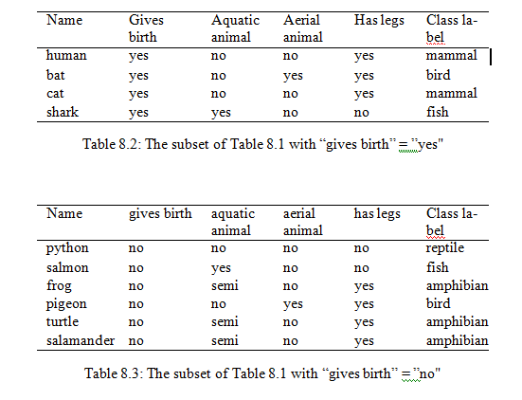
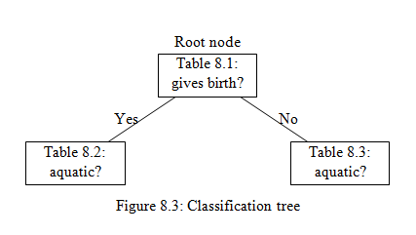

Slide 6
Step 2
We now consider the examples in Table 8.2. We split these examples based on the values of the feature “aquatic animal”. There are three possible values for this feature. However, only two of these appear in Table 8.2. Accordingly, we need consider only two subsets. These are shown in Tables 8.4 and 8.5.
      Table 8.4 contains only one example and hence no further splitting is required. It leads to the assignment of the class label “fish”.
      The examples in Table 8.5 need to be split into subsets based on the values of “aerial animal”. It can be seen that these subsets immediately lead to unambiguous assignment of class labels: The value of “no” leads to “mammal” and the value “yes” leads to ”bird”.
At this stage, the classification tree is as shown in Figure 8.4

Slide 7
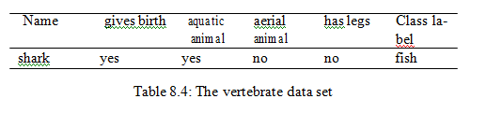
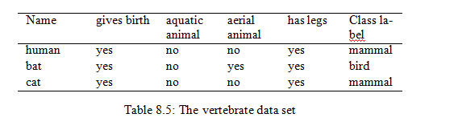
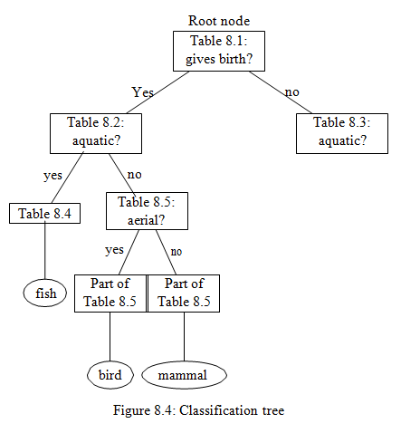

Slide 8
Step 3
Next we consider the examples in Table 8.3 and split them into disjoint subsets based on the values of “aquatic animal”. We get the examples in Table 8.6 for “yes”, the examples in Table ?? for “no” and the examples in Table ?? for “semi”. We now split the resulting subsets based on the values of “has legs”, etc. Putting all these together, we get the the diagram in Figure 8.5 as the classification tree for the data in Table 8.1.

Slide 9
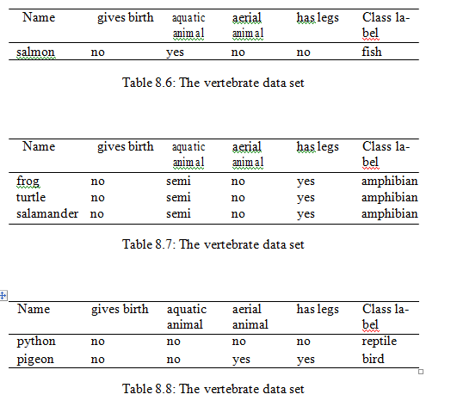

Slide 10
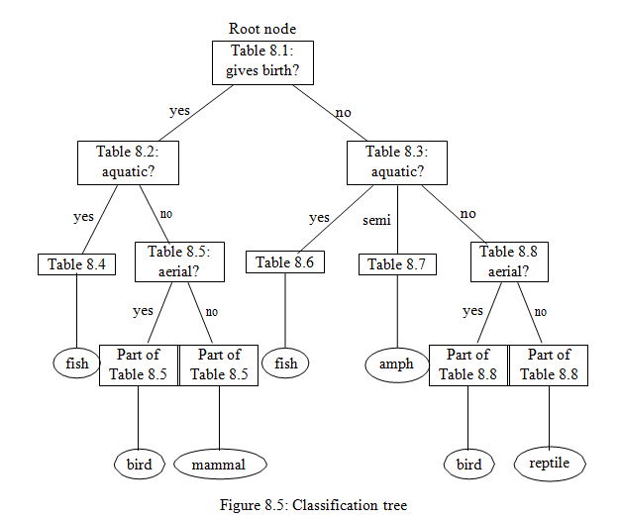

Slide 11
    Some remarks
1. On the elements of a classification tree
The various elements in a classification tree are identified as follows.
  Nodes in the classification tree are identified by the feature names of the given data.
  Branches in the tree are identified by the values of features.
  The leaf nodes identified by are the class labels.

Slide 12
2. On the order in which the features are selected
In the example discussed above, initially we chose the feature “gives birth” to split the data set into disjoint subsets and then the feature “aquatic animal”, and so on. There was no theoretical justification for this choice. We could as well have chosen the feature “aquatic animal”, or any other feature, as the initial feature for splitting the data. The classification tree depends on the order in which the features are selected for partitioning the data.

Slide 13
3. Stopping criteria
A real-world data will contain much more example record than the example we considered earlier. In general, there will be a large number of features each feature having several possible values. Thus, the corresponding classification trees will naturally be more complex. In such cases, it may not be advisable to construct all branches and leaf nodes of the tree. The following are some of commonly used criteria for stopping the construction of further nodes and branches.
  All (or nearly all) of the examples at the node have the same class.
  There are no remaining features to distinguish among the examples.
  The tree has grown to a predefined size limit.

Slide 14
Divide and Conquer Approach
Decision trees are built using a heuristic called recursive partitioning. This approach is generally known as divide and conquer because it uses the feature values to split the data into smaller and smaller subsets of similar classes.
Beginning at the root node, which represents the entire dataset, the algorithm chooses a feature that is the most predictive of the target class. The examples are then partitioned into groups of distinct values of this feature; this decision forms the first set of tree branches. The algorithm continues to divide-and-conquer the nodes, choosing the best candidate feature each time until a stopping criterion is reached. This might occur at a node if:
  All (or nearly all) of the examples at the node have the same class
  There are no remaining features to distinguish among examples
  The tree has grown to a predefined size limit

